Slide 1
Sentiment Analysis Using Subjectivity Summarization Based on Minimum Cuts
Presented by: Sanjana Agarwal and Tejashree Khot

Slide 2
Abstract
To determine sentiment polarity, they’ve used:
A novel machine-learning method that applies text-categorization techniques to just the subjective portions of the document.
The subjective portions of the document have been implemented using efficient techniques for finding minimum cuts in graphs.

Slide 3
introduction
Computational treatment of opinion, sentiment, and subjectivity has recently attracted a great deal of attention.
- Information extraction and question-answering systems could flag statements and queries regarding opinions rather than facts.
- Recommender systems, editorial sites to create summaries of people’s experiences.
Document polarity classification poses several challenges. The approach used:
1) Label the sentences in the document as either subjective or objective, discarding the latter .
2) Apply a standard machine-learning classifier to the resulting extract.
Extraction methods are also based on a minimum cut formulation.

Slide 4
Prevents polarity classifier from considering irrelevant or even potentially misleading text.
Eg. “The protagonist tries to protect her good name.”
Though it contains the word “good”, it tells us nothing about the author’s opinion and in fact could well be embedded in a negative movie review.
Thus, subjectivity extracts can be provided to users as a summary of the sentiment oriented content of the document.

Slide 5
Method
1) Architecture
2) Context and Subjectivity Detection
3) Cut based classification

Slide 6
Architecture
Document-level polarity classification is a special (more difficult) case of text categorization with sentiment rather than topic-based categories. Hence, standard machine learning classification techniques, such as SVMs, can be applied to the entire documents. (Default polarity classifier).
Thus, in the figure on the next page, we see that they built a subjectivity detector.
It determines whether each sentence is subjective or not.
Discard the objective ones and create an extract that represents a review’s subjective content to a default polarity classifier.

Slide 7
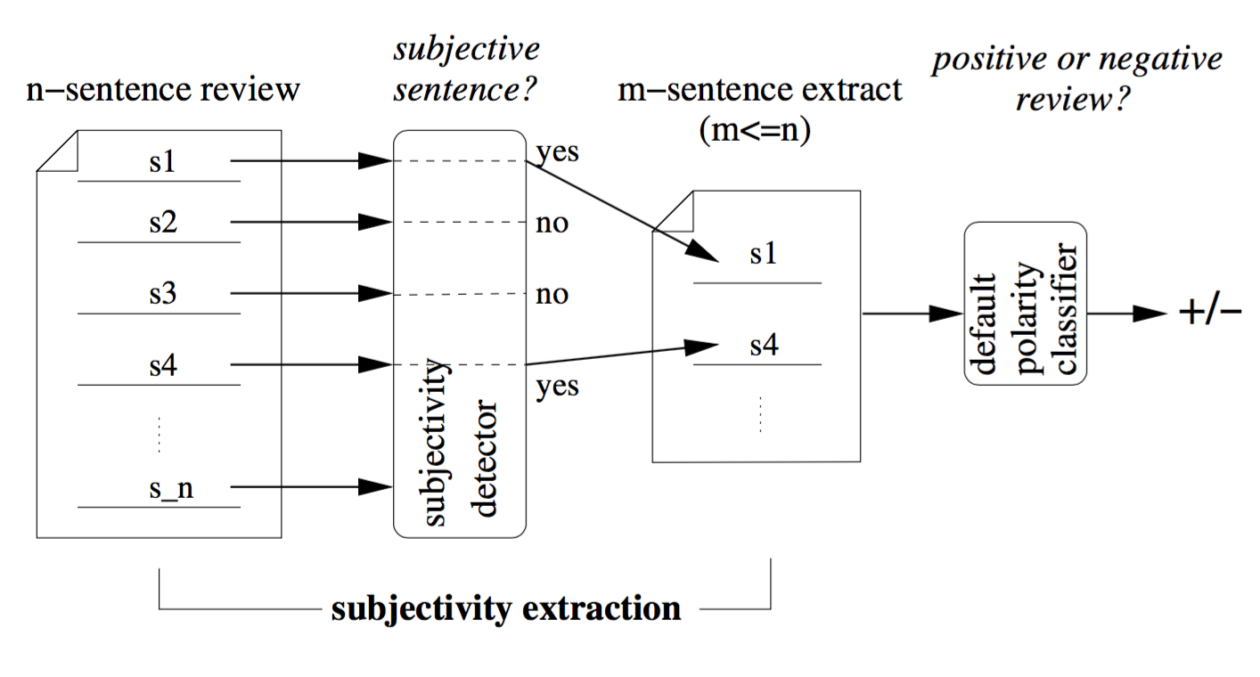
Fig 1. Polarity classification via subjectivity detection.

Slide 8
Context and subjectivity detection
- Subjectivity detection is performed on individual sentences by applying a standard classification algorithm on each sentence in isolation.
- Also, modeling proximity relationships between sentences are used to leverage coherence: text spans occurring near each other may share the same subjectivity status.
Thus, algorithm is supplied with pairwise interaction information i.e. specifying that two particular sentences should ideally receive the same subjectivity label but not state which label this should be.
Algorithm used for this task: Finding minimum cuts (Graph based algorithm)
Notes:
---
Incorporating such information is somewhat unnatural for classifiers whose input consists simply of individual feature vectors, such as Naive Bayes or SVMs, precisely because such classifiers label each test item in isolation. Thus we define synthetic features or feature vectors to attempt to overcome this obstacle.

Slide 9
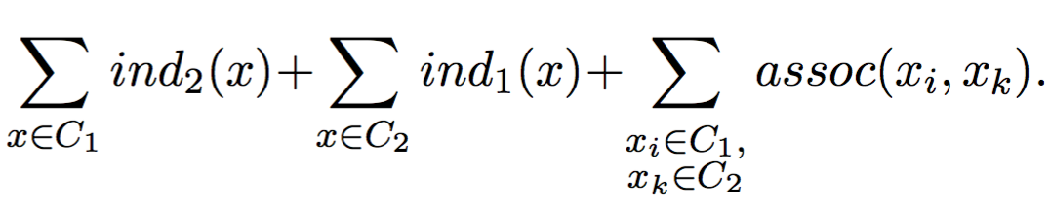
Cut-based Classification
We have n items x₁,...,x_{n} to divide into two classes C₁ and C₂, and access to two types of information:
Individual scores ind_{j} (x_{i}): non-negative estimates of each x_{i}’s preference for being in C_{j} based on just the features of x_{i} alone.
Association scores assoc (x_{i}, x_{k}): non-negative estimates of how important it is that x_{i} and x_{k} be in the same class.
Maximize each item’s net happiness: Its individual score for the class it is assigned to, minus its individual score for the other class.
Penalize for putting tightly associated items into different classes.
Try to minimize the partition cost:
The problem appears intractable, since there are 2^{n} possible binary partitions of the x_{i}’s.

Slide 10
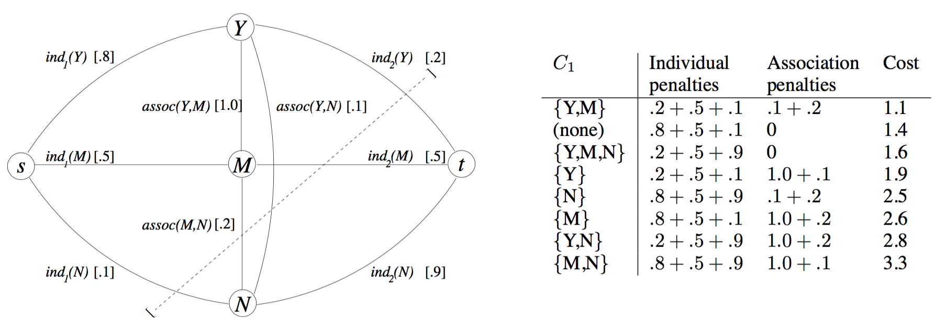

Thus they build an undirected graph G with vertices {v₁, . . . , v_{n}, s, t}; the last two are, respectively the source and sink. Add n edges (s, v_{i}), each with weight ind₁ (x_{i}), and n edges (v_{i}, t), each with weight ind₂ (x_{i}). Cuts in graph G is defined as:
A cut(S,T) of G is a partition of its nodes into sets S = {s} $∪$S’ and T = {t} $∪$ T’, where s $∉$ S’, t $∉$ T’. Its cost cost(S,T) is the sum of the weights of all edges crossing from S to T. A minimum cut of G is one of minimum cost.
Figure 2: Graph for classifying three items.

Slide 11
Advantages:
1) Every cut corresponds to a partition of the items and has cost equal to the partition cost. Thus, the optimization problem reduces to finding minimum cuts.
2) Model item-specific and pairwise information independently using subjectivity detection.
3) Can use maximum-flow algorithms with polynomial asymptotic running times and near-linear running times in practice, to exactly compute the minimum-cost cut.

Slide 12
Evaluation framework
Experiments involve classifying movie reviews as either positive or negative.
The data contains 1000 positive and 1000 negative reviews all written before 2002, with a cap of 20 reviews per author (312 authors total) per category. The corpus is refereed to as the polarity dataset.
Default Polarity Classifiers:
Tested Naïve Bayes and Support Vector Machines.
Used unigram-presence features
Each default document level polarity classifier is trained and tested on the extracts formed by the subjectivity detectors.
Notes:
unigram-presence features: the ith coordinate of a feature vector is 1 if the corresponding unigram occurs in the input text, 0 otherwise.

Slide 13
Subjectivity Dataset:
Require a collection of labeled sentences.
Mined the Web to create a large, automatically labeled sentence corpus.
For subjective sentences : collected 5000 movie review snippets (“bold, imaginative, and impossible to resist”) from www.rottentomatoes.com
For objective sentences: collected 5000 sentences from plot summaries available from the Internet Movie Database www.imdb.com
Selected sentences or snippets were at least ten words long and drawn from reviews or plot summaries of movies released post-2001 to prevent overlap with the polarity dataset.
Subjectivity Detectors:
Default polarity classifiers as “basic” sentence-level subjectivity detectors (after retraining on the subjectivity dataset).
Create a family of cut-based subjectivity detectors; input is the set of sentences appearing in a single document and determine the subjectivity status of all the sentences simultaneously using per-item and pairwise relationship information.
For a given document, build a graph wherein the source s and sink t correspond to the class of subjective and objective sentences.

Slide 14
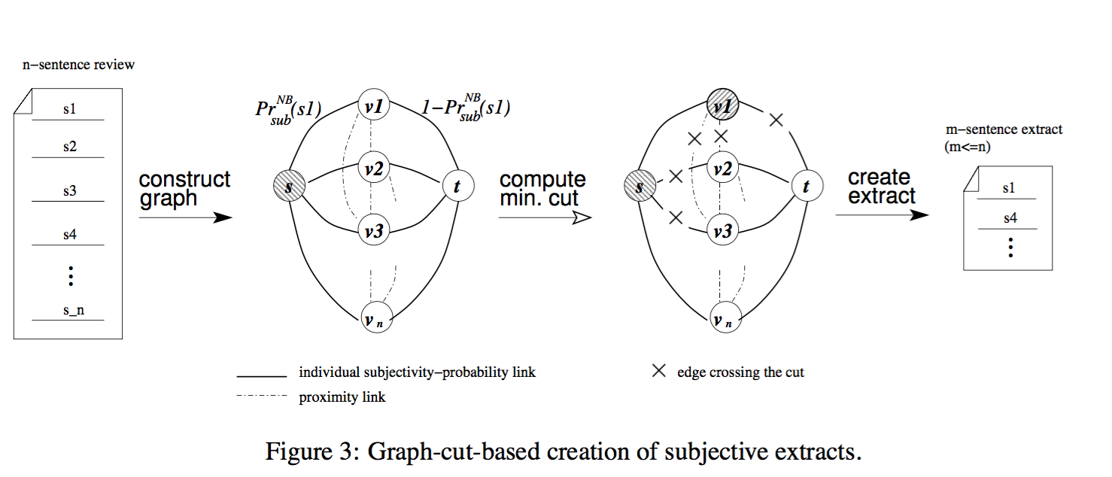

Slide 15
Experimental results
1) Basic subjectivity extraction:
Both Naive Bayes and SVMs can be trained on our subjectivity dataset and then used as a basic subjectivity detector.
Naïve Bayes has somewhat better average tenfold cross-validation performance on the subjectivity dataset (92% vs. 90%)
Employing Naive Bayes as a subjectivity detector (Extract_{NB}) in conjunction with a Naive Bayes document-level polarity classifier achieves 86.4% accuracy.
It is an improvement over 82.8%, when no extraction is applied.
With SVMs as the polarity classifier instead, the Full review performance rises to 87.15%.
Further support comes from a “flipping” experiment: if we give as input to the default polarity classifier an extract consisting of the sentences labeled ‘objective’, accuracy drops dramatically to 71% for NB and 67% for SVM.
The subjectivity extracts are much more compact than the original documents (an important feature for a summary to have). Contain about 60% of the source reviews’ words.
Notes:
but comparison via the paired t-test reveals that this is statistically indistinguishable from the 86.4% that is achieved by running the SVM polarity classifier on Extract_{NB} input.
This confirms our hypothesis that sentences discarded by the subjectivity extraction process are indeed much less indicative of sentiment polarity.

Slide 16
We can create subjectivity extracts of varying lengths:
- N most subjective sentences from the originating review.
- Canonical summarization standard of extracting the first N sentences. (Authors often begin documents with an overview).
- Consider the last N sentences. (in many documents, concluding material may be a good summary, and www.rottentomatoes.com tends to select “snippets” from the end of movie reviews)
-N least subjective sentences according to Naive Bayes.

Slide 17
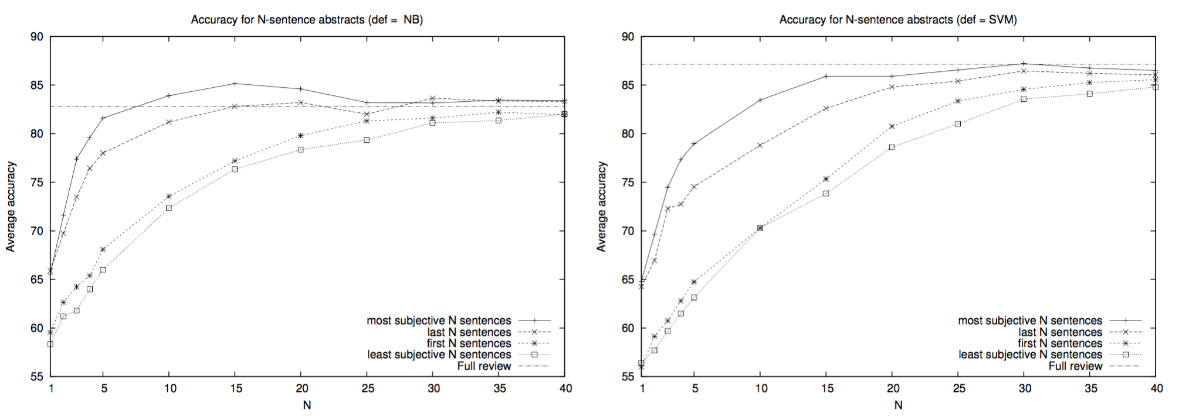
The figure shows the polarity classifier results as N ranges between 1 and 40.
NB detector provides very good “bang for the buck”: with subjectivity extracts containing as few as 15 sentences, accuracy is quite close to what one gets if the entire review is used.
Just using the 5 most subjective sentences is almost as informative as the Full review while containing on average only about 22% of the source reviews’ words.

Slide 18
Observations:
1) At N = 30, performance is actually slightly better than (but statistically indistinguishable from) Full review. (87.2% vs. 87.15%)

Slide 19
Overall observations for basic subjectivity extraction
1) N most subjective sentences method generally outperforms the other summarization methods.
2) Also, how much better the last N sentences are than the first N sentences.
Notes:
This may reflect a (hardly surprising) tendency for movie-review authors to place plot descriptions at the beginning rather than the end of the text and conclude with overtly opinionated statements.

Slide 20
Incorporating context information
Contextual constraints are easily incorporated via the minimum-cut formalism but are not natural inputs for standard Naive Bayes and SVMs.
Extract_{NB+Prox} and Extract_{SVM+Prox} are the graph-based subjectivity detectors using Naive Bayes and SVMs, respectively, for the individual scores.
The context-aware graph-based subjectivity detectors tend to create extracts that are more informative (significant for SVM subjectivity detectors only), although these extracts are longer than their context-blind counterparts.
Performance enhancements cannot be attributed entirely to the mere inclusion of more sentences regardless of whether they are subjective or not.
Thus, these experiments reveal that the graph-cut formulation is a better approach: for both default polarity classifiers (NB and SVM).
Some choice of parameters yield statistically significant improvement over its non-graph counterpart.
Notes:
Full review yielded substantially worse results for the NB default polarity classifier— and at any rate, the graph-derived extracts are still substantially more concise than the full texts

Slide 21
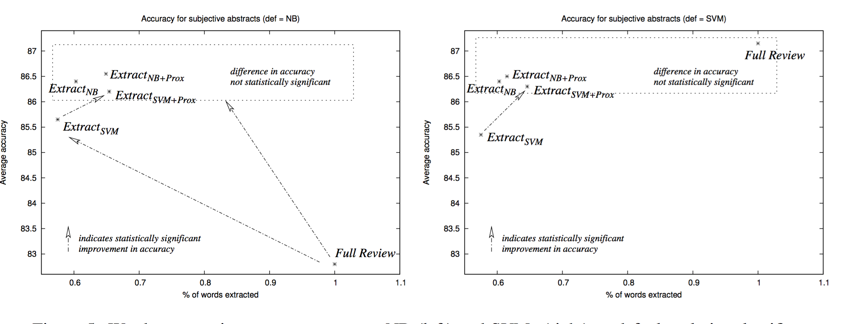
Figure: Word Preservation Rate vs. Accuracy

Slide 22
Conclusion
1) Subjectivity detection can compress reviews into much shorter extracts that still retain polarity information at a level comparable to that of the full review.
2) For the Naive Bayes polarity classifier, the subjectivity extracts are shown to be more effective input than the originating document.
3) Employing the minimum-cut framework results in the development of efficient algorithms for sentiment analysis. Utilizing contextual information via this framework can lead to statistically significant improvement in polarity classification accuracy.
Notes:
End of point 2. which suggests that they are not only shorter, but also “cleaner” representations of the intended polarity.

Slide 23
The end

